Slide 1

Participatory Evaluation
The Fieldworx Way
Eleesa Johnstone

Slide 2
Participatory Evaluation
What is it?
  Evaluation taken from the point of view of those most affected by program/initiative
  Key stakeholders key drivers of process
  Process that is reflective, action oriented and builds capacity
  Provides opportunities for learning, change and improvement
  Evaluator is not positioned as expert - value add by facilitating learning’s
  Levels of participation continuum (IAP2)

Slide 3
Public Participation
Iap2
INFORM
CONSULT
INVOLVE
COLLABORATE
EMPOWER

Slide 4
Values Driven Evaluation
Core values and beliefs underpin this style of work & should guide implementation
  Learning - Solution oriented and builds capacity
  Participation - Those closest to the issues generally have the best solutions
  Flexibility – continuous process of review and learning
  Transparency – no secrets

Slide 5
Why do it?
  Builds capacity
  Reveals insights
  Encourages creativity and ownership of issues and solutions
  Creates opportunities for sustainable change

Slide 6
Who is it best suited to?
  People who are curious to learn about relevance, significance and appropriateness of an initiative not just the outputs of program
  People who have insights that might be missed through other forms of evaluation or that may fall into the ‘hard to engage’ categories
  Evaluators who can balance the role as facilitators and partners not observer or critique (though these skills are used)

Slide 7
Challenges we encounter
Immersing yourself in others world and the fine line between impartiality and trusted colleagues/supervisor
Balancing the role as facilitator and evaluator
Tension between telling the story that the data tells you and the one that clients want to hear
Clients who want to control the story….
Balancing process and outcome

Slide 8
Lessons we have learnt..
Have a clear to guide process – STEER TM Strategy
Underlying assumptions – ask the right questions, to the right people to get the right information
Understand client type – the 4C’s
Evaluation reference group
Program logic – story telling
Clarify your role as evaluator - be prepared to be a learning facilitator
Understand lifecycle of process
Use a variety of tools/techniques
Build in workshop times

Slide 9
STEER STRATEGY TM – Ask the right questions to the right people to get the right information
SCOPE
TAILOR
Build relationship and keep building it...This is really about doing what we said we would do plus a bit more to ensure people are energised, motivated and enjoying the process.
EVALUATE
REPORT
Establish relationship with client
Get to the heart of what is required of the project
Agree the scope, budget and timeline
Seek to understand the stakeholders involved and the decision making process
ENGAGE
Ensure an open and transparent process
Maintain regular client contact
Ensure there are no surprises.
Be flexible - things change over time
Constantly review and question our approach to ensure best outcomes.
It might be verbal or written, but there is always a report at the end of a project tailored to clients needs
Match our methodology and approach to project delivery to the specific needs of our client.

Slide 10
Understand Clients Needs

Slide 11
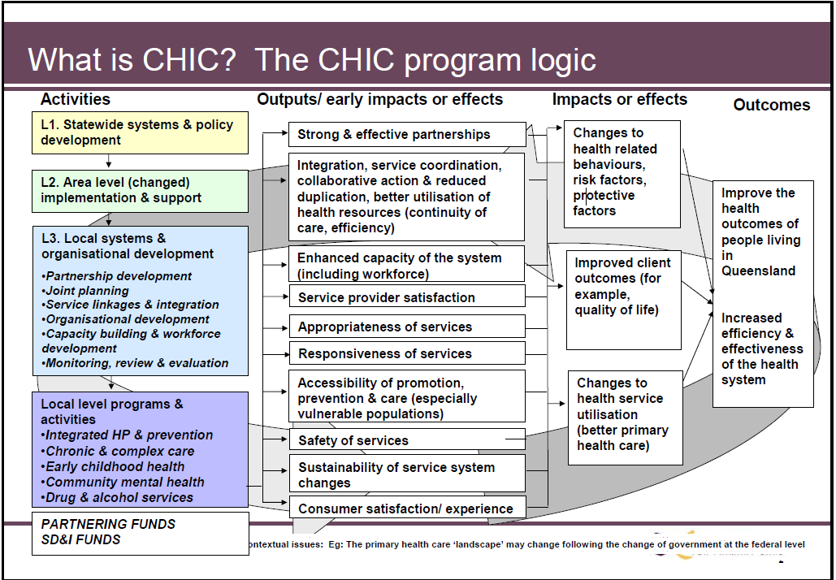

Slide 13
Lessons we have learnt..
Clarify your role as evaluator - be prepared to be a learning facilitator
Understand lifecycle of process
Use a variety of tools/techniques
Build in workshop times

Slide 14
Tools
Most Significant Change Technique
Scaling tools to notice and measure change
Picture Cards – strength based and solution focused (St Luke’s)
Action Learning/Research – What we tried? What worked and why? What got in the way and why? What will we do differently next time?
Facilitation & Workshop techniques – Technology of Participation, Focused Questioning, World Café etc…
Program logic as the story to be told
Usual evaluation methodologies/techniques - interviews, surveys, focus groups, web 2.0

Slide 15
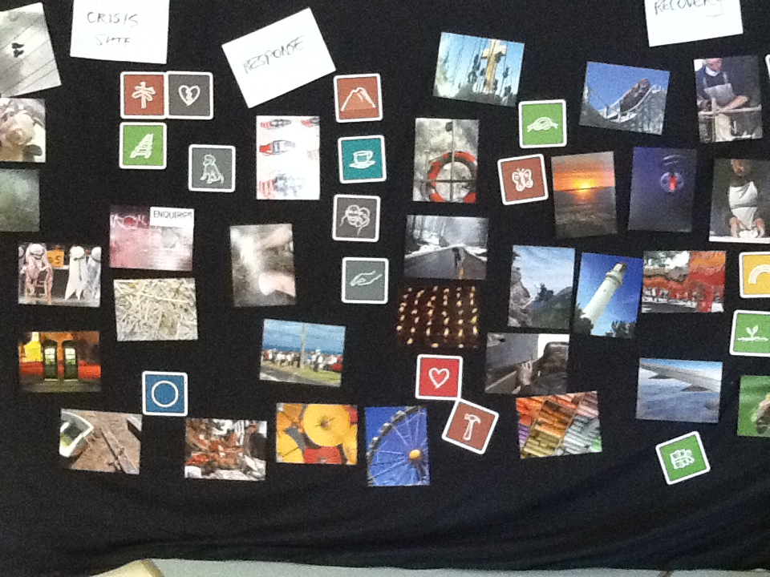

Slide 16
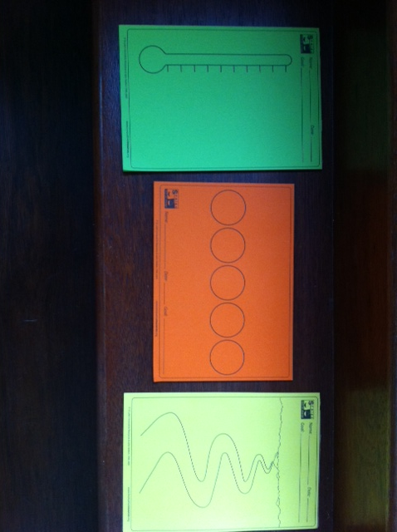

Slide 17
Thanks
You can find out more by checking out our website at
www.fieldworx.com.au

